Slide 1

Machine Learning Applications in Bitcoin: Forecasting, Trading, and Risk Management
Sam, Bill, Jannis (and HWTeng)
National Yang-Ming Chiao-Tung University
Machine Learning and FinTech
https://github.com/HWTeng-Teaching/202509-ML-FinTech
20251110 IDA Template Keynote.key

Slide 2
Motivation
Data Preprocessing
Factor Engineering & EDA
Cross-Sectional ML Prediction
Portfolio strategy
Future Work
IDA Template

Slide 3
Motivation
Motivation
Cryptomarket is highly volatile, non-linear and noisy
Predicting concrete values highly complex task
Instead try to rank assets relatively to each other
IDA Template

Slide 4
Section Title
Data Preprocessing
Data sources
Open, High, Low, Close, Volume (Binance Spot Market)
daily OHLC, market capitalization, and volume data (CoinGecko)
4-week Treasury Bill rate (DTB4WK)
Build dataset with weekly frequency
Universe: Top 30 assets
Title

Slide 5
Section Title
Data Preprocessing
Exploratory Data Analysis
Missing value analysis
Descriptive statistics
Cross-sectional correlation Analysis
Factor Distribution Analysis
Time Series Stability Analysis
Principal Component Analysis
Information Coefficient Analysis
Title

Slide 6
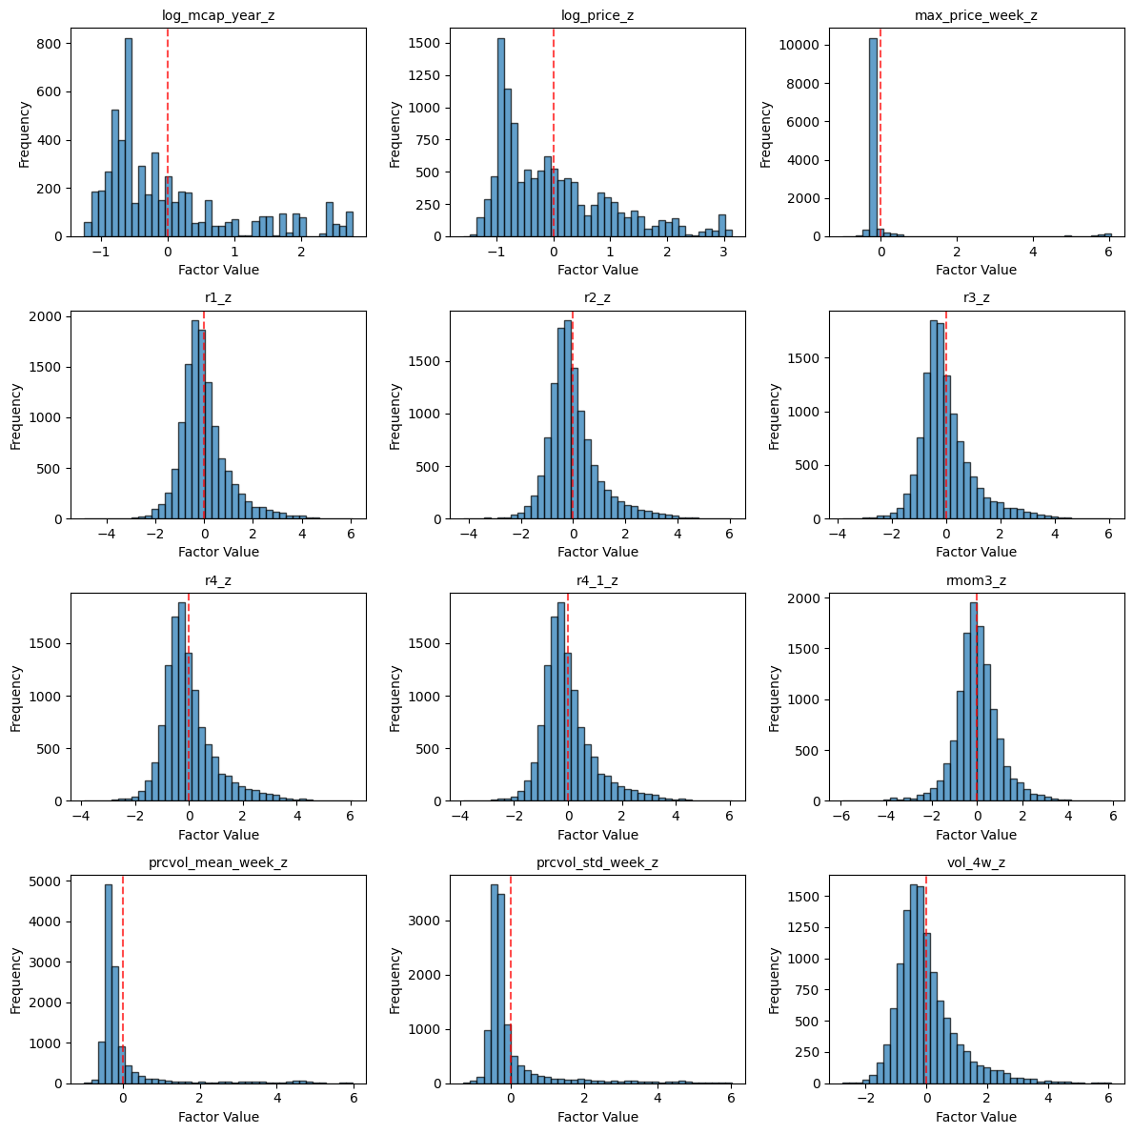
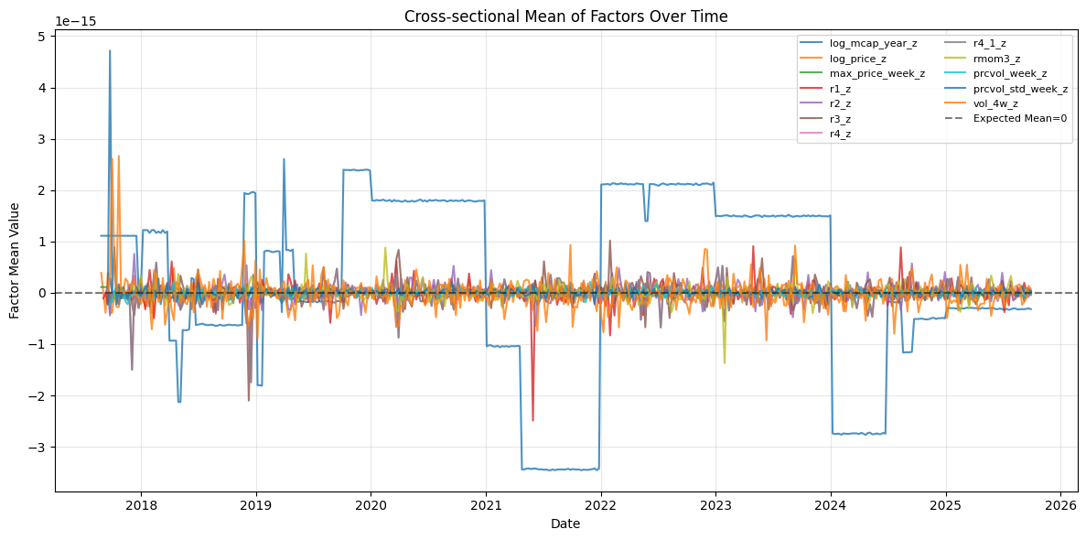
Section Title
Data Analysis
Title

Slide 7
Section Title
Factor Engineering & EDA
Engineer features
Momentum
Value
Size
Fama-MacBeth Regression: Assess feature predictive power
Factor-Mimicking portfolios: risk exposure and contribution to return dynamics
Preprocessing: Weekly cross-sectional standardization
Title

Slide 8
Section Title
Cross-Sectional ML Prediction
Goal: Rank assets each week to predict next-week performance for portfolio formation
Predict next-week excess return
Baseline: Ridge Regression
Primary model: LightGBM Ranker
Ensemble: 0.7 x Ranker + 0.3 x Ridge
Rolling training: 52-week lookback window
Title

Slide 9
Section Title
Portfolio strategy
Sort each week by model prediction (excess return)
Strategy: long top 5, short bottom 5
Trading cost: 10 bps/side
Advantage: market (beta) neutral
Title

Slide 10
Section Title
Future Work
Better machine model / ensemble
Optimize hyperparameters
Title

Slide 11
Section Title
Strategy Performance
Benchmark: BTC buy & hold
Sharpe: 0.4
Return: 411
MDD: -0.66
Ensemble model: LightGBM + Ridge Regression
Sharpe: 0.4
Return: 5239.58
MDD: -0.83
Turnover: 0.8
Title

Slide 12
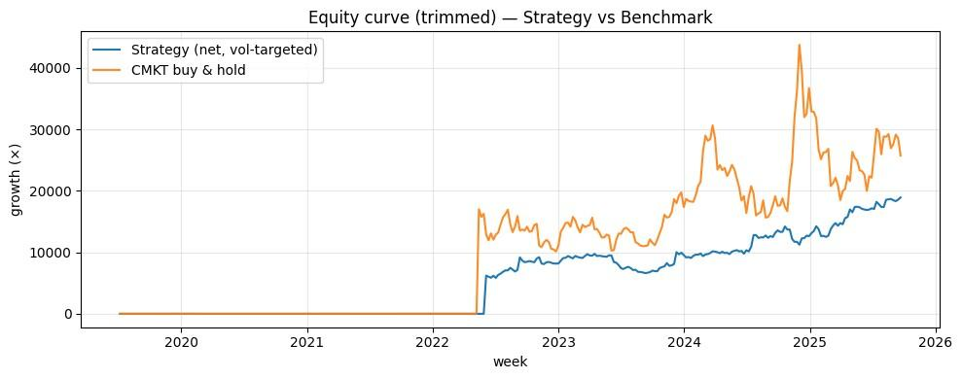
Section Title
Strategy Performance
Title

Slide 13
Section Title
Conclusion
Title

Slide 14
Machine Learning Applications in Bitcoin: Forecasting, Trading, and Risk Management
Sam, Bill, Jannis (and HWTeng)
National Yang-Ming Chiao-Tung University
Machine Learning and FinTech
https://github.com/HWTeng-Teaching/202509-ML-FinTech
20251110 IDA Template Keynote.key

